Slide 1
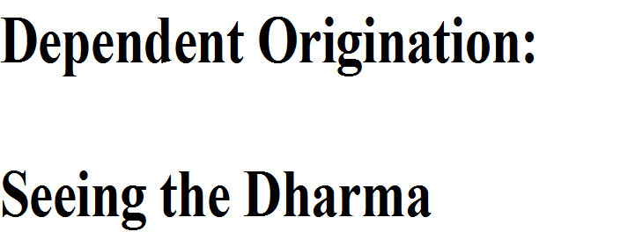

Slide 2
Dependent Origination
as a Buddhist Psychology
and Context for Practice

Slide 3
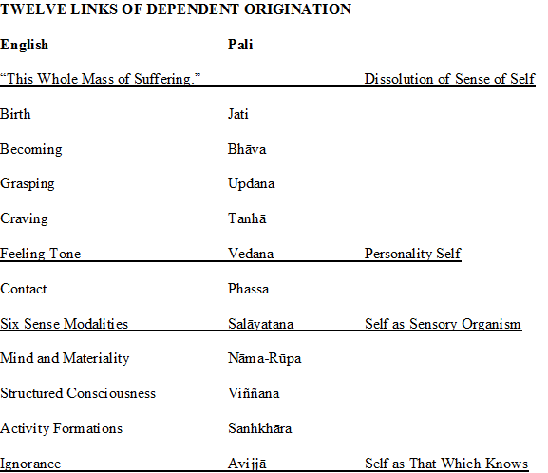

Slide 4
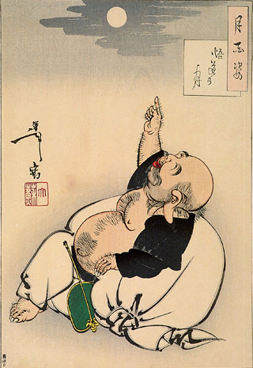

Slide 6
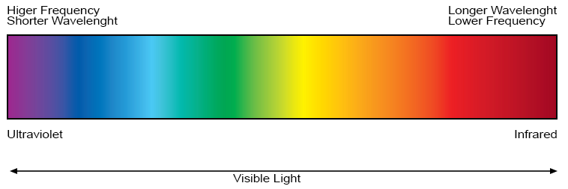

Slide 7
R.A. I. N.

Slide 8
R.A.I.N.
Recognize
Recognize that an emotion is happening.
Make the emotion the focus of mindful attention as what’s happening right now.
Give the emotion a one or two word linguistic label that fits.
Attend/Accept/Allow
With recognize we’re already attending to the emotion of the moment. After applying a label we continue this mindful attention to the emotion.
Letting go of any aversion or resistance, any grasping hold of, we simply accept the emotion just at it is.
Having accepted the emotion, we now allow it to be as it wishes to be, to change if it wishes to change. We give it its autonomy.
And we watch mindfully what it does.

Slide 9
R.A.I.N., Cont’d
Investigate
How does the emotion really feel (pleasant, neutral, or unpleasant feeling tone)?
Is it fixed or changing/dynamic?
If dynamic, how is it changing?
Where is the emotion located? Is it associated with any bodily sensations?
How intense, how energetic, is this present-moment version of this emotion?

Slide 10
R.A.I.N., Cont’d
Natural but Not Self
Emotions are Naturally occurring, a Normal part of life.
    They are important common human denominators
    They make us human and like all other humans, thus connecting us to the rest of humanity rather than isolating us or making us unique.
    The details of our story may be unique but the emotions at its core are deeply human.
Not who or what I am but rather something that happens to me.
Not permanent/lasting.

Slide 11
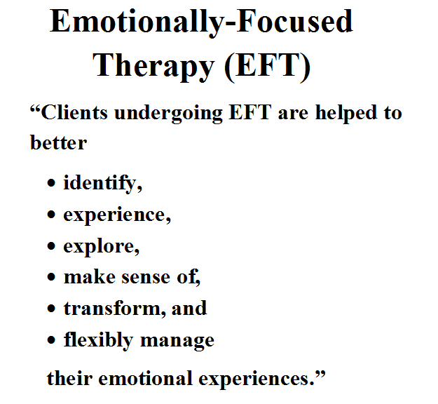

Slide 12
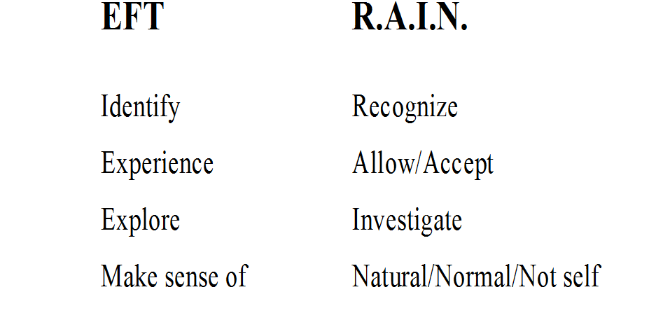

Slide 14
“Archetypes are unconscious universal structures, inherited blueprints, or templates, which organize psychic energy along certain repeatable and recognizable lines.”
Hester Solomon

Slide 15
The Subtle Body
“The psyche operating through its substrate of organized energy patterns ….”
Mansfield and Spiegelman

Slide 16
Participatory Consciousness
“…states of consciousness which are unobstructed by a delusionary sense of a separate self.”
Aftab Omer

Slide 17
“There is only one core issue in all of psychology. Where is the ‘me’? Where does the ‘me’ begin? Where does the ‘me’ stop? Where does the ‘other’ begin. … Where does psyche stop and matter begin?”
James Hillman

Slide 18
“The cut between the self and natural world is arbitrary, we can make it at the skin or we can take it as far out as you like – to the deep oceans and distant stars. But the cut is far less important than the uncertainty about making the cut at all. This uncertainty opens the mind to wonder again, allowing fresh considerations to enter the therapeutic equation.”
James Hillman

Slide 19
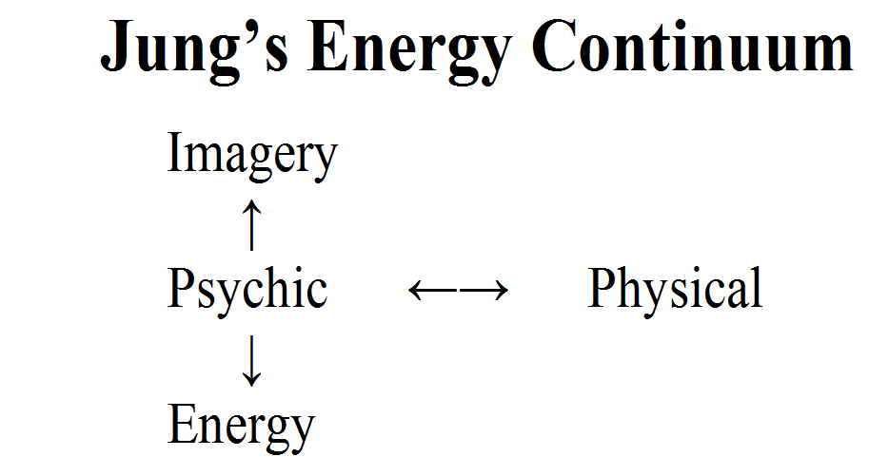

Slide 20
Visionary Imagery in Spiritual Practice
Psychological significance.
Harbinger – a brief glimpse of what’s to come.
Symbolic depiction of experiential insights.
Tools for practice, e.g., Tantric traditions of India and Tibet.
  Images that catalyze the insights the symbolize.
Pointing the way forward, laying out the path ahead.

Slide 21


Slide 22
Dedication of Merit
Throughout our many lives and until this moment
Whatever virtue we have accomplished
Including the merit generated by our teaching, listening, discussing,
and practicing together these past eight weeks
And all that we may ever attain
This we offer for the welfare of beings.
May sickness, famine, war and suffering be decreased for every being
While their wisdom and compassion increase in this and every
future life.
May we quickly attain Enlightenment
In order to work ceaselessly for the liberation of all sentient beings.
adapted from Chagdud Tulku Sangha

Slide 23
Wise Intention
May we live each day in a way that shows kindness to others.
May we practice unceasingly steadiness and clarity of mind.
May steadiness and clarity become the perfection of wisdom.
May wisdom manifest as ever more boundless compassion.
May compassion act with precise and skillful means.
May our precise and skillful actions lead all beings to freedom.
May the freedom of all beings solely motivate this unending practice.
May this impeccable motive remain everpresent in mind.

